Slide 1

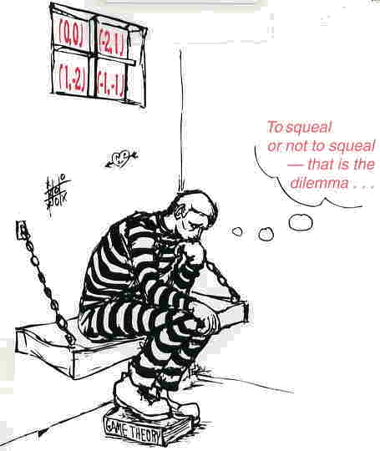
Game Theory,
Markov Game, and Markov Decision Processes:
A Concise Survey
Cheng-Ta Lee
August 29, 2006

Slide 2
Outline
Game Theory
Decision Theory
Markov Game
Markov Decision Processes
Conclusion

Slide 3
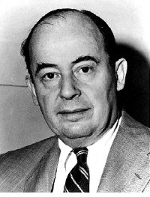
Game Theory (1/3)
Game theory is a branch of economics.
  von Neumann, J. and Morgenstern, O. “Theory of Games and Economic Behavior,” Princeton University Press, 1944.
Game theory (for modeling cooperation and competition in multi-agent system).

Slide 4
Game Theory (2/3)
Key assumption
  Players are rational
  Players choose their strategies solely to promote their own welfare (no compassion for the opponent)
Goal: To find an equilibrium:
  Equilibrium: local optimum in the space of policies

Slide 5
Game Theory (3/3)
The elements of such a game include:
  Players (Agents)：decision makers in the game
  Strategies ： predetermined rules that tell a player which action to take at each stage of the game
  Payoffs (table)： utilities (dollars) that each player realizes for a particular outcome
  Equilibrium ： stable results. Here stable results mean that each player behaves in the desired manner and will not change its decision.

Slide 6
Prisoners Dilemma
Strategies
Prisoner 2
Don’t
confess
Confess
Confess
(-6, -6)
(0, -9)
Prisoner 1
Don’t
confess
(-9, 0)
(-1, -1)
Players
Payoff (Utility)

Slide 7
Example
Value of the game,
Saddle-point,
Nash Equilibrium
Player B
 | 1 | 2 | 3 | 4
1 | 8 | 2 | 9 | 5 | 2
2 | 6 | 5 | 7 | 18 | 5
3 | 7 | 3 | -4 | 10 | -4
 | 8 | 5 | 9 | 18
Row: Minimum
Player A
Maximin
Column: Maximum
Minimax

Slide 8
Classification of Game Theory
Two-person, zero-sum games
  One player wins = The other one loses
Two-person, constant-sum games
N-person game
Nonzero-sum game

Slide 9
Outline
Game Theory
Decision Theory
Markov Game
Markov Decision Processes
Conclusion

Slide 10
Decision Theory (1/2)
Probability Theory
+
Utility Theory
=
Decision Theory
Describes what an agent should believe based on evidence.
Describes what an agent wants.
Describes what an agent should do.

Slide 11
Decision Theory (2/2)
The decision maker needs to choose one of the possible actions
Each combination of an action and a state of nature would result in a payoff (table)
This payoff table should be used to find an optimal action for the decision maker according to an appropriate criterion

Slide 12
Outline
Game Theory
Decision Theory
Markov Game
Markov Decision Processes
Conclusion

Slide 13
Markov Game
Markov games is an extension of game theory to MDP like environments
  Markov game assumption such that the decisions of users are only based on the current state

Slide 14
Outline
Game Theory
Decision Theory
Markov Game
Markov Decision Processes
Conclusion

Slide 15
Markov Decision Processes (1/2)
Markov decision processes (MDPs) theory has developed substantially in the last three decades and become an established topic within many operational research.
Modeling of (infinite) sequence of recurring decision problems (general behavioral strategies)
MDPs defined
  Objective functions
    Utility function
      Revenue
      Cost
  Policies
    Set of decision
      Dynamic (MDPs)

Slide 16
Markov Decision Processes (2/2)
Three components: Initial state, transition model, reward function
Policy: Specifies what an agent should do in every state
Optimal policy: The policy that yields the highest expected utility

Slide 17
MDP vs. MG
Single agent: Markov Decision Process
  MDP is capable of describing only single-agent environments
Multi-agent: Markov Game
  n-player Markov Game
  optimal policy: Nash equilibrium

Slide 18
Outline
Game Theory
Decision Theory
Markov Game
Markov Decision Processes
Conclusion

Slide 19
Conclusion
Markov
property
Markov Decision
Processes (MDP)
Markov Game
Generally
Decision Theory
Game Theory
Single-agent
Multi-agents

Slide 20
References (1/3)
Hamdy A. Taha, “Operations Research: an Introduction,” third edition, 1982.
Hillier and Lieberman,”Introduction to Operations Research,” fourth edition, Holden-Day, Inc, 1986.
R. K. Ahuja, T. L. Magnanti, and J. B. Orlin, “Network Flows,” Prentice-Hall, 1993.
Leslie Pack Kaelbling, “Techniques in Artificial Intelligence: Markov Decision Processes,” MIT OpenCourseWare, Fall 2002.
Ronald A. Howard, “Dynamic Programming and Markov Processes,” Wiley, New York, 1970.
D. J. White, “Markov Decision Processes,” Wiley, 1993.
Dean L. Isaacson and Richard W. Madsen, “Markov Chains Theory and Applications,” Wiley, 1976
M. H. A. Davis “Markov Models and Optimization,” Chapman & Hall, 1993.
Martin L. Puterman, “Markov Decision Processes: Discrete Stochastic Dynamic Programming,” Wiley, New York, 1994.
Hsu-Kuan Hung, Adviser：Yeong-Sung Lin ,“Optimization of GPRS Time Slot Allocation”, June, 2001.
Hui-Ting Chuang, Adviser：Yeong-Sung Lin ,“Optimization of GPRS Time Slot Allocation Considering Call Blocking Probability Constraints”, June, 2002.

Slide 21
References (2/3)
高孔廉，「作業研究--管理決策之數量方法」，三民總經銷，民國74年四版。
李朝賢，「作業研究概論」，弘業文化實業股份有限公司出版，民國66年8月。
楊超然，「作業研究」，三民書局出版，民國66年9月初版。
葉若春，「作業研究」，中興管理顧問公司出版，民國86年8月五版。
薄喬萍，「作業研究決策分析」，復文書局發行，民國78年6月初版。
葉若春，「線性規劃理論與應用」，民國73年9月增定十版。
Leonard Kleinrock, “Queueing Systems Volume I: Threory,” Wiley, New York, 1975.
Chiu, Hsien-Ming, “Lagrangian Relaxation,” Tamkang University, Fall 2003.
L. Cheng, E. Subrahmanian, A. W. Westerberg, “Design and planning under uncertainty: issues on problem formulation and solution”, Computers and Chemical Engineering, 27, 2003, pp.781-801.
Regis Sabbadin, “Possibilistic Markov Decision Processes”, Engineering Application of Artificial Intelligence, 14, 2001, pp.287-300.
K. Karen Yin, Hu Liu, Neil E. Johnson, “Markovian Inventory Policy with Application to the Paper Industry”, Computers and Chemical Engineering, 26, 2002, pp.1399-1413.

Slide 22
References (3/3)
Wal, J. van der. “Stochastic Dynamic Programming,” Mathematical Centre Tracts No. 139, Mathematisch Centrum, Amsterdam, 1981.
Von Neumann, J. and Morgenstern, O. “Theory of Games and Economic Behavior,” Princeton University Press, 1947.
Grahman Romp, “Game Theory :Introduction and Applications ,” Oxford university Press, 1997.
Straffin, Philip D. “Game Theory and Strategy,” Washington :Mathematical Association of America, 1993.
Watson, Joel. “Strategy :An Introduction to Game Theory ,” New York :W.W. Norton, 2002.

Slide 23
Thank you for your attention!

